Slide 1
Data Science Fundamentals
Dimensionality Reduction

Slide 2
Before we get started…
Practicalities

Slide 3
Learning objectives
You understand and apply different types of regression, know when and how to use them, can execute them and put them in to practice as well as interpret the results.
You recognize overfitting in regression models and learn techniques to prevent overfitting.
You learn about different clustering techniques and understand when and how to use them for grouping data.
You gain an understanding of dimensionality reduction techniques and learn how to apply
them to compress and visualize data.

Slide 4

Course material
Canvas
  Slides & exercises from classes
Online
  https://www.w3schools.com/datascience/
Software
  JupyterLab (or work via Anaconda/VS Code if you prefer)
The Internet

Slide 5
Course breakdown
Course Structure:
  Lectures: 3 hours per week (theory and exercises)
  Attendance: Mostly not compulsory, but strongly recommended.
Examination Breakdown:
  30%: Continuous assessment (mandatory exercises)
  70%: Final exam (oral, mostly theoretical with some practical elements)

Slide 6

Is it difficult to pass?
It’s perfectly doable if you put in the work
Come to class
Participate in the lessons
Make your exercises

Slide 7
How to be an ideal student
Attend classes - even when you party hardy
Show respect - towards your instructor and fellow students
Be punctual - or you'll find the door closed
Meet deadlines - late submissions will earn a solid zero
Have a question? - just ask! I don't bite
Know it all? - help your classmates, they might repay you with pizza
Do your own work! - shortcuts will lead to a short academic career ;)

Slide 8
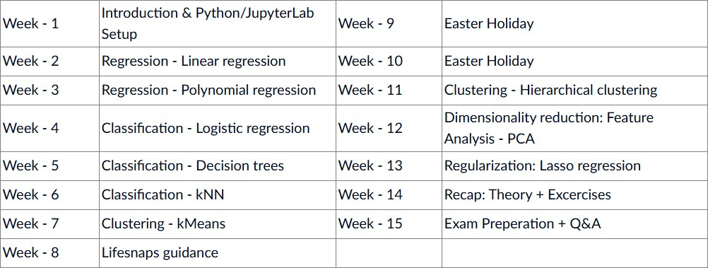
Syllabus
(subject to change)

Slide 9
Now we get to the fun part
Dimensionality Reduction

Slide 10


Slide 11

Dimensionality Reduction
Sometimes our data is too big to store/to explore manually
Ideally, we want to keep all data points
Solution: reduce the amount of variables
• = dimensionality reduction
Unsupervised learning process
Reduce the amount of variables in a dataset
Ideal scenario: no information loss
Realistic scenario: minimal information loss
Notes:
Aantal dimensies (= variabelen) verminderen ZONDER dat je informatie verliest.
Realistisch is dat niet lol. Een beetje informatie zal altijd verloren gaan.
Dimensionality reduction = UNSUPERVISED!

Slide 12
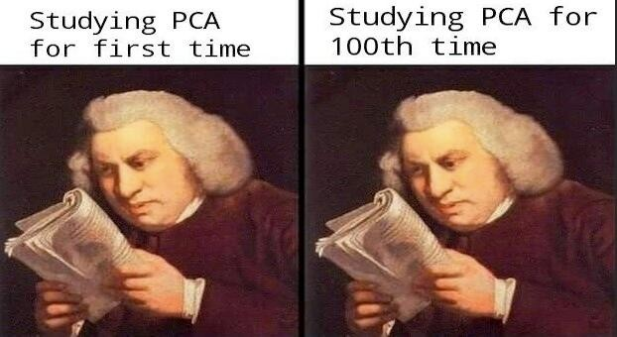
PCA
‘Principal Component Analysis’: reduce the variables to a few ‘principal components’
Only one of the many dimensionality reduction techniques available
Bundle variables with high correlations together
Try to keep as much explained variance in the dataset as possible
Keep only principal components with enough explained variance
Notes:
Principle component analysis: omvormen van variabelen naar PCA!!!
Maar 1 van de zoveel methoden.
Je hebt heel veel variabelen die op elkaar lijken: je zoekt naar de variabelen met een hoge correlatie: die variabelen gooi je samen. Je houd enkel de informatie over die interessant is tussen de variabelen.
Explained variance: nuttige informatie. De verschillen in jouw datasets die interessant. Kijken of iets paard of hond is: paar pixels die snuit hond of snuit paard maken, zal het verschil maken: dat is de explained variance.

Slide 13
Eigenvalues
Eigenvalues tell us how much variance is explained by a principal component
High eigenvalue = high variance
High variance = lots of useful information
Every principal component has its own eigenvalue
Rank them from biggest to smallest → choose how many you want to keep

Slide 14
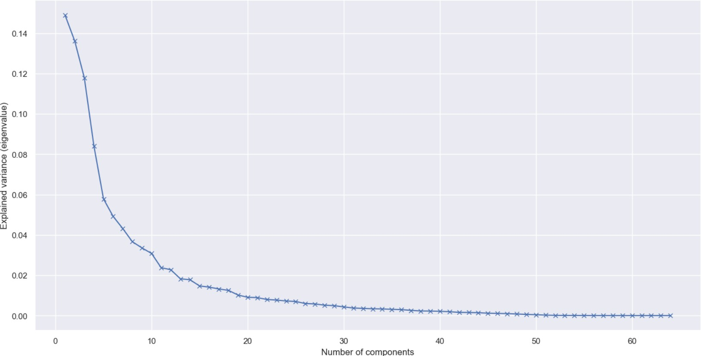
Finding the ‘best’ amount of components
Plot the eigenvalues in function of
the number of components
Does this graph look familiar?
Elbow method!

Slide 15
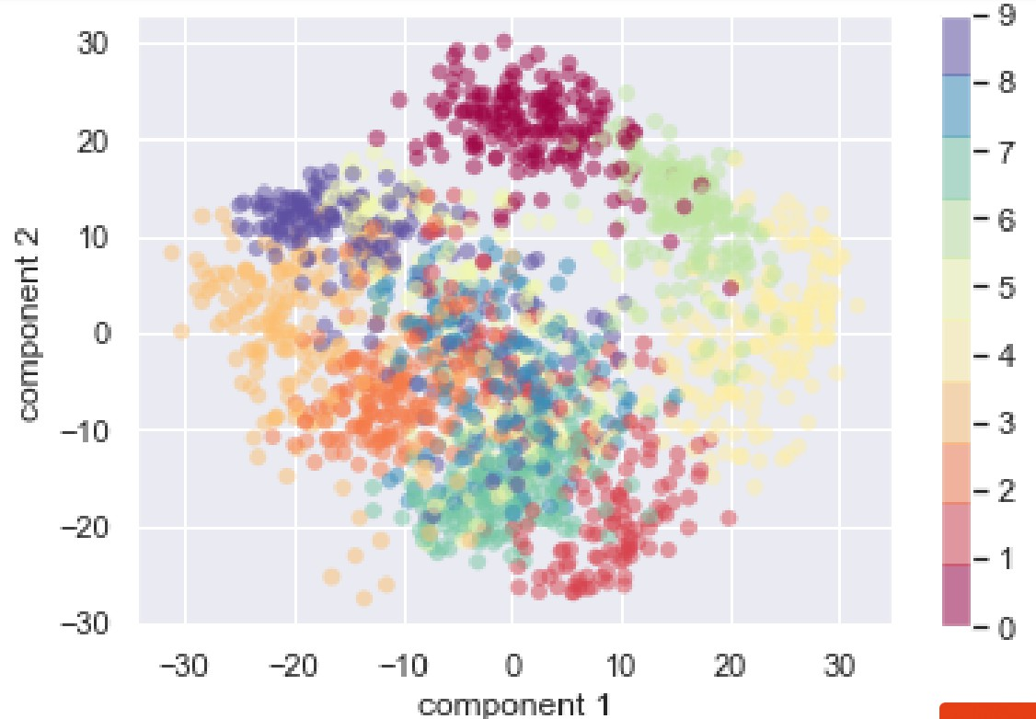
Pusing PCA to the extreme
What happens when we push PCA to
the extreme?
Take the digits dataset
Reduce it to only 2 components
Even now we can still make out the
different numbers!
Even with a reduction in variables of
97%!
This show just how powerful PCA is

Slide 16
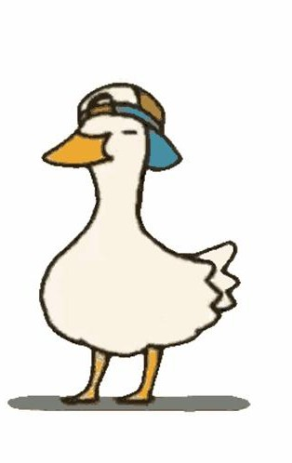
Overfitting
Since it is a dimensionality reduction technique, overfitting is not really a thing
However, make sure you don’t reduce your data too much or you might lose
valuable information!
Same as with clustering, just use the elbow method and you’ll be fine :D

Slide 17
Other uses of PCA
Dimensionality reduction
  Feature extraction
  Data compression
Data visualization
  See digits dataset in two dimensions
Noise reduction
  By only keeping the principal components with high variance, we ‘filter’ out
noise

Slide 18
Let’s jump into action
Excercises

Slide 19

First, let’s explore this together
Go to canvas and download the notebook “DSF 09 – Dimensionality Reduction Notebook”
Open the notebook in Jupyter
  Open a CMD and run “jupyter lab”
  Or launch it via anaconda
Follow along!

Slide 20

Now it’s up to you!
Go to canvas and download the notebook “DSF 09 – Dimensionality Reduction Exercise”
This time, no csv file is needed
The data needed is retrieved in the notebook itself :)
Open the notebook in Jupyter
  Open a CMD and run “jupyter lab”
  Or launch it via anaconda
Go through the notebook and make the excercises
I don’t bite, ask me any questions you have!

